Slide 1
Welcome to 5th Grade ELA
Assessment today on: Summarizing, Compare/Contrast, Cause/Effect, Main Idea/Details, and Greek/Latin Roots

Slide 2
Class Expectations
Give me a green check and earn a participation point when you are ready to follow the class expectations! ☺

Slide 3
What’s My Grade Today?
Everyday you will get a participation grade based on your classroom activity.
Take a look at the chart to see how you measure up!!
**You will also be graded on your turned in assignments each week.

Slide 5
Plans for Tomorrow
Your teacher will not be here, so we will not have a class connect session. Please check the weebly: www.nvva5.weebly.com for your assignment. We will be practicing writing, focusing on the 10 steps.

Slide 6
Today’s Assessment
Today you will be assessed on the skills we have practiced in reading so far. You will have a task for each of the following: summarizing, cause/effect, compare/contrast, main idea/details, and Greek/Latin roots.
All we ask is that you try your best. Do not rush through this assessment, you will have the rest of the class period to finish it. When you finish, please raise your hand. A teacher will check for completion (not correctness) and then dismiss you.

Slide 7
Rubric – How will I be graded?
Main Idea/Details = 5 points
Summarizing = 5 points
Compare/Contrast = 5 points
Cause/Effect = 3 points
Greek/Latin Roots = 10 points
Write your name! = 2 points
TOTAL = 30 points

Slide 8
Tasks #1&2
Please read the article and fill out the summary chart. Then write a brief summary about the article.
Identify the main idea and details of Leaping Lizards. Complete the main idea/details chart.

Slide 9
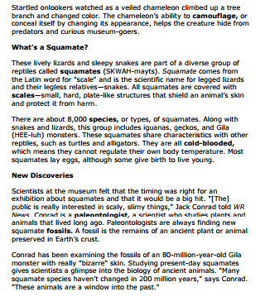
Leaping Lizards!

Slide 10
Main Idea/Details
Topic:
Main Idea:
Supporting Detail:
Supporting Detail:
Supporting Detail:
Continue

Slide 11
Summarizing Leaping Lizards
Continue

Slide 12
Summary of Leaping Lizards
Continue

Slide 13
Tasks #3&4
Please read the article “Big Birds, Big City” and complete the compare/contrast chart. Hint: Use the chart on page 3 to help you.
After reading the article “Big Birds, Big City”, please complete the cause/effect chart. Remember to use complete sentences and specific details. (Stay away from saying things like “it has” or “they have”) Make sure to include specifics!

Slide 14
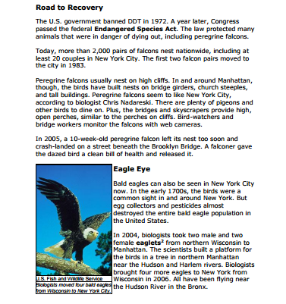
Big Birds, Big City

Slide 15
Big Birds, Big City

Slide 16
Continue

Slide 17
Cause & Effect (Whole Group)
2. What caused it to happen?
1. Think about what happened in today’s reading.
Continue
Notes:
Try to complete the right side of the chart first by listing 3 events that happened. Then, consider what caused those events to happen. Mention to students that this will be independent practice for tomorrow’s class.
Inferential What led to the rise of the Aztec Empire?
»» Answers may vary, but should include multiple factors: the Aztec
constantly waged war against neighboring city-states, which resulted in
population growth and expansion of power; the Aztec emperor collected
taxes from the people in the empire, which contributed to its great wealth.
2. Inferential What led to the rapid fall of the powerful Aztec Empire?
»» Answers may vary, but should include multiple factors: in waging war
against other city-states, the emperor created resentment amongst those
who were conquered; Hernán Cortés arrived with the intent to claim
the empire for the Spanish; the resentful city-states supported Cortés’s
mission; European diseases killed thousands of people.
3. Evaluative Who or what do you think was ultimately responsible for the Aztec
Empire coming to an end? Use the text to support your argument.
»» Answers may vary, but should include that, although many factors were
at play in the Aztec Empire coming to an end, Hernán Cortés is generally
accepted as the person who defeated the Aztec Empire. Additional
possibilities include: Hernán Cortés was responsible because he brought
people to help him take down the empire; the Spaniards were responsible for
bringing disease, which led to the death of thousands of people; the emperor
led fiercely, which turned city-states against him, ultimately helping Cortés.

Slide 18
Tasks #5
Complete the following slide matching the Greek and Latin roots to their meaning.

Slide 19
Greek Roots Match the root to the meaning:
Auto
Bio
Graph
Hydro
Therm
Water
Self
Heat
Life
Write

Slide 20
Latin Roots Match the root to the meaning:
Audi
Dict
Ject
Port
Rupt
To move
To break
To hear
To speak
To throw

Slide 21
Hello…Hello…Hello…
Are you there? Your teacher has tried to contact you several times in the chat and microphone, but it seems that you are Missing in Action. In order to get off the island and rejoin the group, you must do the following:
Write your name on this slide
Give us a green check
Send your teacher a private chat explaining how you plan to get back on task
*Please remember that participation is an important part of your grade

Slide 22
Refocus
Please reflect upon your behavior in order to refocus you attention back to what is taking place in class. Once you have responded to each question below, please raise your hand and wait for your teacher to move into the breakout room to review with you.
Your name:
What was the inappropriate behavior?
When and where did this occur?
How did this behavior interfere with your learning or the learning of others?
What positive choices will you make next time?

